Slide 1
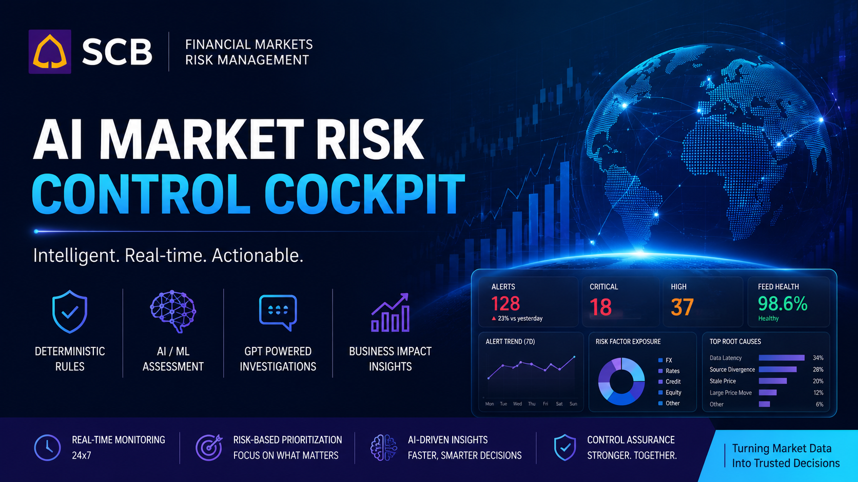
SCB
AI-Powered Value at Risk Market Data Quality
Control Cockpit

Slide 2
Today, we’re demonstrating an AI-powered Market Data Quality Control Cockpit for Market Risk. Our pilot focuses on FX market data, helping risk analysts automatically detect, prioritise, and investigate market data quality issues before they impact valuations, VaR calculations, and trading decisions.
AI MARKET RISK CONTROL COCKPIT
Detect • Prioritise • Explain • Investigate
1. MARKET DATA SOURCES
2. DATA QUALITY VALIDATION
3. AI ANOMALY DETECTION
4. MARKET CONTEXT ENRICHMENT
Reuters
Bloomberg
Internal Market Data Feed
Exchange Prices
Reference Data
Historical Market Data
Stale Prices
Feed Latency
Vendor Price Mismatch
Large Price Movement
Missing or Invalid Values
Detect unusual market behaviour
Learn historical patterns
Identify anomalies missed by static rules
Market Scenario
Trading Session
Related Risk Factors
Market Volatility
Vendor Agreement
Historical Alert Patterns
7. ANALYST COCKPIT
6. GENERATIVE AI INVESTIGATION
5. BUSINESS IMPACT PRIORITISATION
Explain:
What happened
Why is it suspicious?
Business Impact
Posible Root Cause
Recommended Next Action
VaR Impact
Trading Exposure
Estimated P&L Impact
Portfolio Criticality
│ 📊 Dashboard
│ 🚨 Prioritised Alerts
│ 🤖 AI Assessment
│ 📝 Investigation Report
│ ✔ Human Decision & Audit Trail
Rank alerts from Highest to Lowest Business Risk

Slide 3
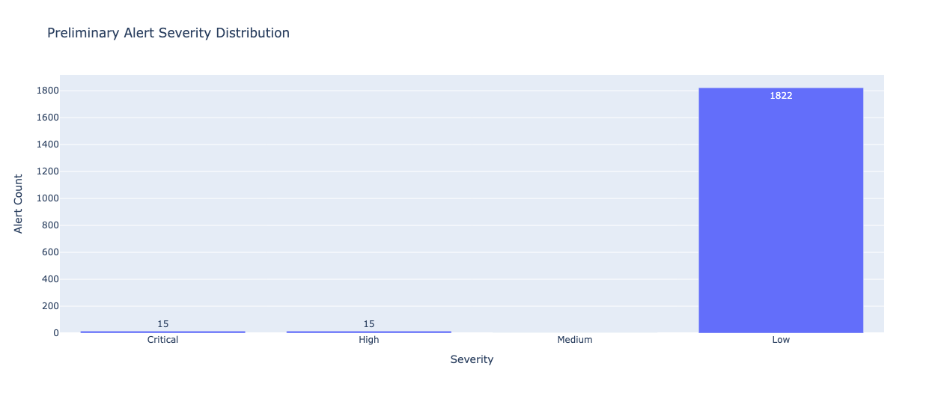
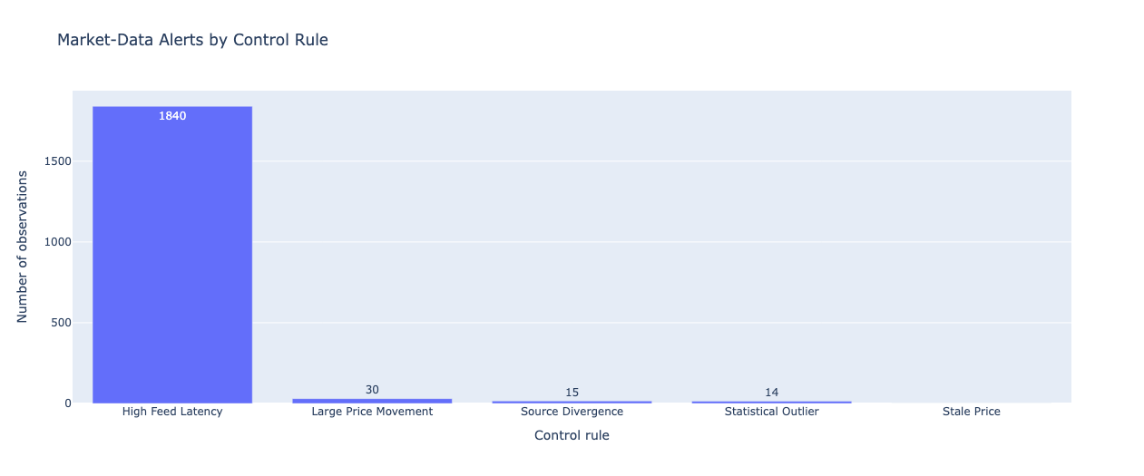
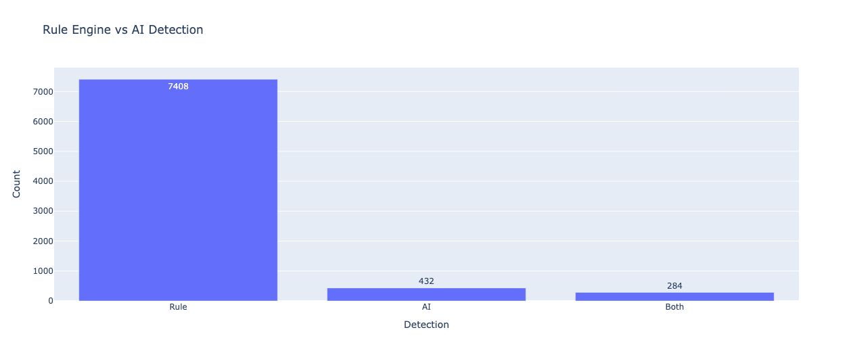

Slide 4
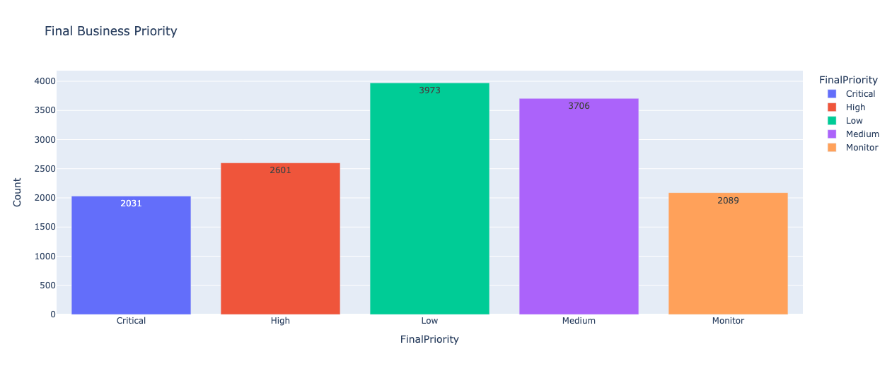
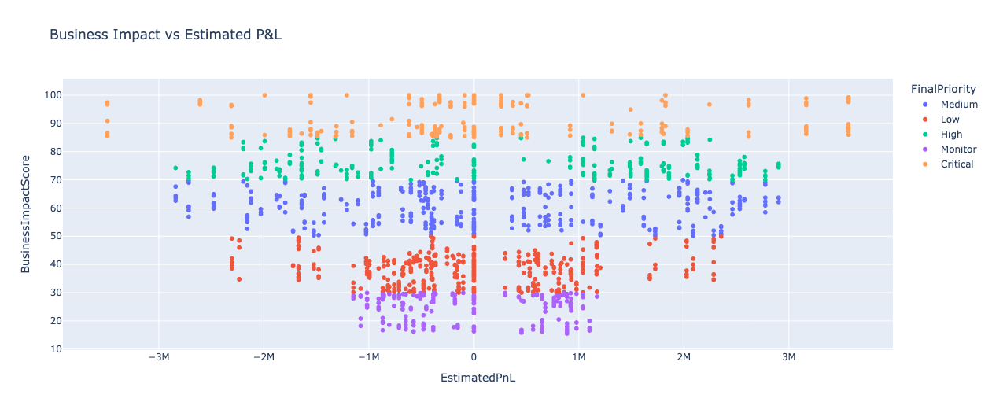

Slide 5
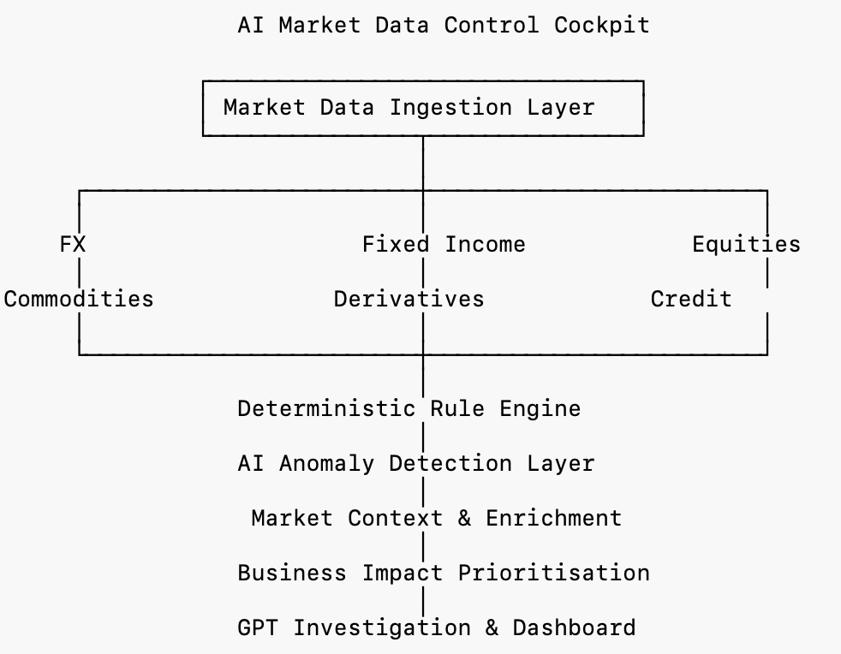
Today’s demonstration focuses on FX market data because it allowed us to validate the complete end-to-end workflow. However, the platform has been designed as a reusable control framework. By introducing asset-specific deterministic rules and connecting additional market data feeds, the same cockpit can monitor fixed income, equities, commodities, derivatives, credit markets, and even calculated risk metrics such as VaR or Expected Shortfall. This enables a single AI-powered control platform for enterprise-wide market data governance.

Slide 6
Capability | Hackathon Implementation | Proposed Production Implementation
Market Data Source | Synthetic FX market data (Reuters/Bloomberg simulation in CSV) | Live market data from Reuters, Bloomberg, ICE, exchanges, or internal market data platforms via streaming APIs
Data Processing | Python (Pandas) in Google Colab | Databricks, Apache Spark, Azure Data Factory, or Kafka Streams for scalable real-time processing
Rule Engine | Python-based deterministic validation rules | Enterprise Business Rules Engine (e.g., Drools) or centrally managed configurable rule service integrated with market data governance
AI Anomaly Detection | Isolation Forest (Scikit-learn) | Azure ML, Databricks ML, or enterprise MLOps platform with continuous monitoring, retraining, and model governance
Market Context Enrichment | Simulated scenarios and derived context | Live economic calendars, market news, volatility indices, reference data, peer asset movements, and macro event feeds
Business Impact Engine | Python calculations using synthetic exposures, P&L, and VaR | Integration with Market Risk systems using live positions and risk measures
Generative AI Investigation | OpenAI GPT API | Azure OpenAI or approved enterprise LLM with Responsible AI controls, prompt governance, audit logging, and human approval workflow
Dashboard | Streamlit | React/Angular web application with Power BI, Grafana, or internal enterprise dashboard framework
Alert Storage | CSV files | Enterprise database (Azure SQL, PostgreSQL, Cosmos DB) with full audit trail
Workflow & Case Management | Manual review | Integration with ServiceNow, or enterprise incident management platforms
Authentication & Security | None (prototype) | Enterprise IAM (Azure AD/Entra ID), RBAC, MFA, encryption, and full audit logging
Deployment | Google Colab | Azure Kubernetes Service (AKS), Azure App Service, OpenShift, or bank-approved cloud platform with CI/CD
Monitoring & Observability | Manual execution | Azure Monitor, Datadog, Splunk, Prometheus/Grafana, automated alerting, and operational dashboards

